Slide 1
Objectives
After completing this chapter you will be able to understand:
  What are JSP implicit objects?
  How to handle form using JSP?

Slide 2
What are implicit objects?
Implicit objects in JSP are the objects that are created by the web container automatically and the container makes them available to the JSP to access it.
Implicit objects are available only inside the _jspService() method hence cannot be accessed anywhere outside.

Slide 3
List of Implicit Objects
Object | Class | Description
request | javax.servlet.ServletRequest | Reference to the current request
response | javax.servlet.ServletResponse | HttpServlet response object for the current request.
session | javax.servlet.http.HttpSession | Session associated with the current request
application | javax.servlet.ServletContext | Servlet context to which a page belongs
page | java.lang.Object | An instance of the JSP page's servlet class that processes the current request.

Slide 4
List of Implicit Objects
Object | Class | Description
pagecontext | javax.servlet.jsp.PageContext | Object to access request, response, session and application associated with a page.
out | javax.servlet.jsp.JspWriter | Object that writes to the response output stream.
config | javax.servlet.ServletConfig | Servlet configuration for the page.
exception | java.lang.Throwable | This objects is available in JSP pages where the page directive isErrorpage is set as true stating that it is an error page for some other JSP page. The error message can be displayed from this object.

Slide 5
Processing Values in Servlet Context
Values can be stored in the servlet context for making it available for all servlets in the application by setting it as an attribute to the JSP implicit object named application .
application.setAttribute(“visitorCount“,count) - Sets attribute to the application context.
application.getAttribute(“visitorCount") - Reads attribute from the application context.
application.removeAttribute(“visitorCount") - Removes attribute from the application context.

Slide 6
Handling Request and Response Object
JSP provides both request and response as implicit objects . All the HttpServletRequest and HttpServletResponse methods can be called on these objects
Example :
request.getParameter(“name”) ;
response.sendRedirect(“home.jsp”);
We will learn more on using these objects during lend a hand session.

Slide 7
Form Processing JSP
Rendering Forms :
Forms can be rendered as normal HTML forms inside JSP pages.
Forms can also be created dynamically by printing using the out.print() method if required.
Example:
<%
out.print(“<form>”);
out.print(“<input type=‘text’ name=‘userName’/>”);
out.print(“</form>”);
%>

Slide 8
Form Processing JSP
Handling Forms Actions :
Form actions can be handled by the same JSP or another servlet/JSP.
  Example: When user clicks the login button in Login.jsp it can be handled by Login.jsp or HomePage.jsp or LoginValidator.java (Servlet)
If the same JSP is handling the form action then the form action attribute need not be specified.
Example: <form name=“LoginForm” method=“get”> // No action attribute specified.

Slide 9
Lend a Hand – JSP form Processing
In this demo we familiarize how forms can be developed and handled using JSP.
Here the form action will be handled by the same JSP itself.
JSP’s to be developed
login.jsp – Page which captures user name, password for login. The same page should be designed to process the login request and validated.
  If user name is “tom” and password is “jerry” the login is considered successful.
success.jsp – In case of success the control should be redirected to the success page.

Slide 10
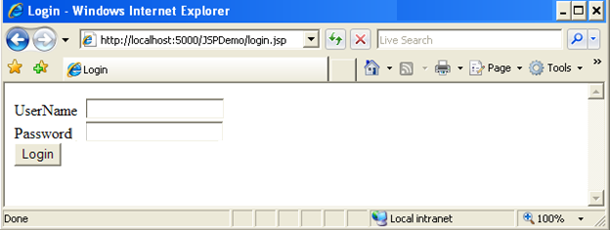
Lend a Hand – Login Page design.
Create a login page as shown in the screen shot below The page should have the following components
User Name – Text box
Password – Password field
Login – Submit Button

Slide 11
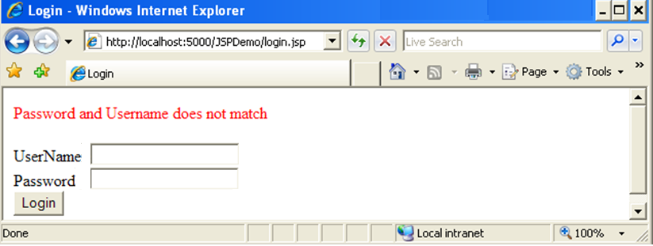
Lend a Hand – Invalid Login Page Design
In case of invalid login the output should be as shown .

Slide 12
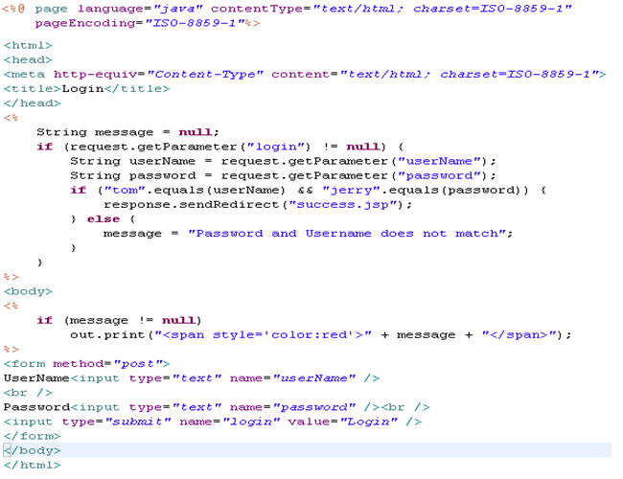
Lend a Hand – login.jsp code
Performs the form processing as below,
If the request parameter value for the submit button is not null it means form is submitted else the form is accessed using URL.
The other parameter values are read using the get parameter method validate user name and password as mentioned.
Prints the error message

Slide 13
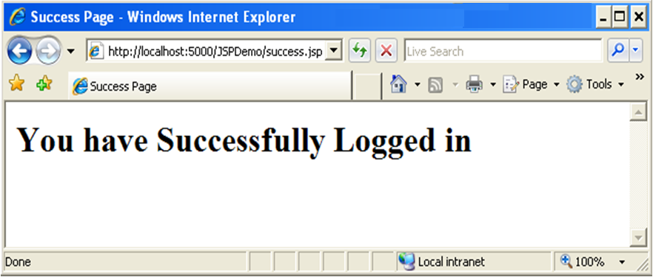
Lend a hand – Success page design
In case of successful login the control to be redirected to success page which should display a message as illustrated below.

Slide 14
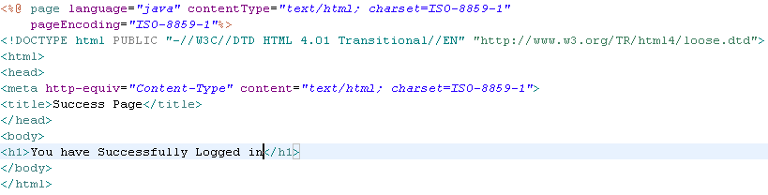
Lend a Hand – success.jsp
Develop success page as illustrated below

Slide 15
Lend a Hand - Deploy and Run
Step 1 : Deploy and run the application
Step 2 : Invoke login.jsp from the browser
http://localhost:5000/JSPDemo/login.jsp
Step 3 : Enter tom as username and jerry as password
You will be redirected to the success page
Step 4 : Invoke login.jsp from the browser . Enter incorrect username and password.
You will see the invalid login error message printed.

Slide 16
Hands on – Registration Application
Associates should develop the following hands on with the guidance of trainers
A registration application should be implemented based on the requirement depicted below,
The user invokes registration page from the browser – registration page rendered to the user.
User fills the registration form and submits the form – If all fields are not null the entered details should be displayed in a details page in a tabular form with name and value as the column headers.
User enters null value to any of the fields – The user is redirected to the same registration page with the appropriate error message printed.

Slide 17
Hands on – Registration Application
The following JSP pages needs to be developed,
Registration.jsp – Page which captures registration details.
Details.jsp – This will process the request from registration.jsp , if any of the mandatory values is null the control should be redirected to the registration page. If the entered details are proper display the details entered in a tabular format.
Error Message Format: “Password cannot be null”
  Hints :
  Make details.jsp the action page of registration form.
  To pass the error message from details.jsp to registration.jsp set it as query string parameter to the URL
  Example :response.sendRedirect(“registration.jsp?message=‘User Name , Password cannot be null’ ”);

Slide 18
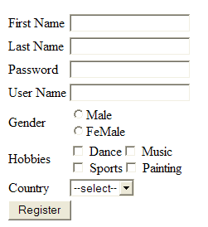
Hands on – Registration Page Fields
Create an Email Registration form using JSP with the following fields. The ones with the * marks are mandatory fields to be validated.
First Name * : Text Box
Last Name * : Text Box
Password * : Password Field
Gender * : Radio Button
Hobbies : Check Box
Values: Music ,Dance , Sports , Painting
Country : Combo box
Register - Submit button

Slide 19
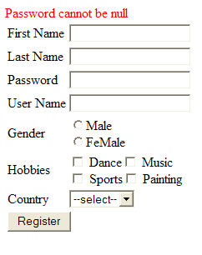
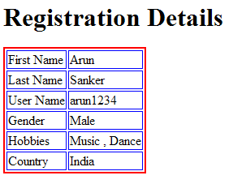
Hands on – Details and Error page design
Error Page
Details Page

